Slide 1
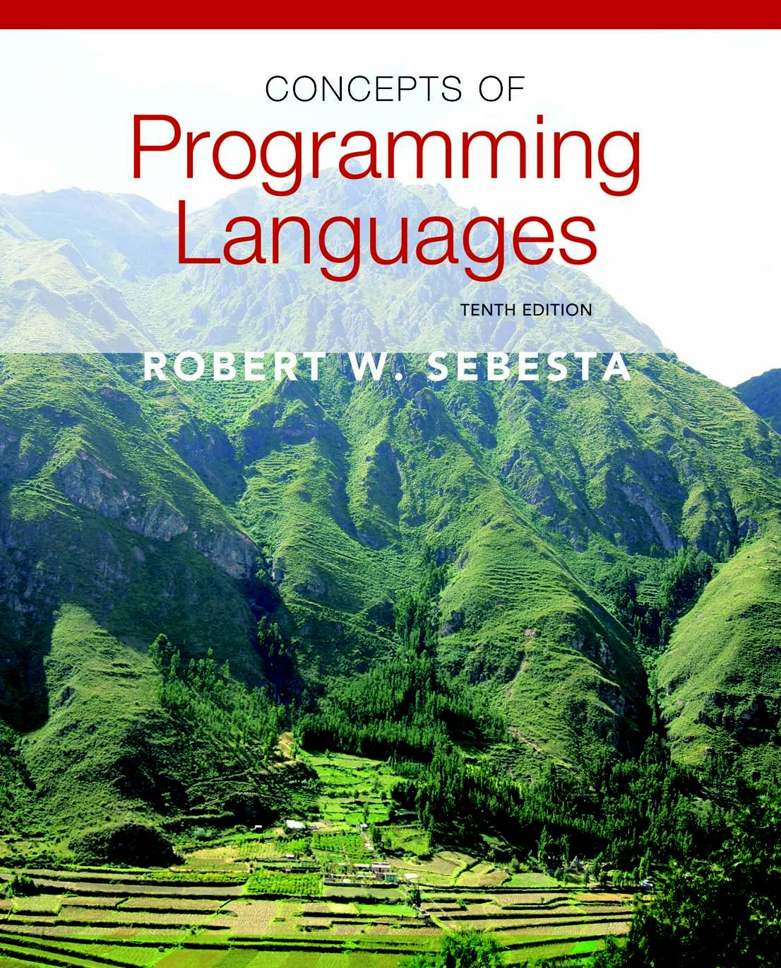
Copyright © 2012 Addison-Wesley. All rights reserved.

Slide 2
Lecture 5: Expressions and Assignments
CS408
(Chapter 7 )

Slide 3
Topics
Introduction
Arithmetic Expressions
Overloaded Operators
Type Conversions
Relational and Boolean Expressions
Short-Circuit Evaluation
Assignment Statements
Mixed-Mode Assignment

Slide 4
Introduction
Expressions are the fundamental means of specifying computations in a programming language
To understand expression evaluation, need to be familiar with the orders of operator and operand evaluation
Essence of imperative languages is dominant role of assignment statements

Slide 5
Arithmetic Expressions
Arithmetic expressions consist of operators, operands, parentheses, and function calls
Design issues for arithmetic expressions
Operator precedence rules?
Operator associativity rules?
Order of operand evaluation?
Operand evaluation side effects?
Operator overloading?
Type mixing in expressions?

Slide 6
Arithmetic Expressions: Operators
Operators: unary, binary …
Operator precedence rules
for expression evaluation
define the order in which “adjacent” operators of different precedence levels are evaluated
Typical precedence levels
parentheses
unary operators
** (if the language supports it)
*, /
+, -

Slide 7
Arithmetic Expressions: Operator Associativity Rule
Define the order in which adjacent operators with the same precedence level are evaluated
Typical associativity rules
Left to right, except **, which is right to left
Sometimes unary operators associate right to left (e.g., in FORTRAN)
APL is different; all operators have equal precedence and all operators associate right to left
Precedence and associativity rules can be overriden with parentheses

Slide 8
Conditional Expressions
Conditional Expressions
C-based languages (e.g., C, C++)
An example:
average = (count == 0)? 0 : sum / count
Evaluates as if written like
if (count == 0)
average = 0
else
average = sum /count
Expressions vs. Statements
Major difference?
Why need conditional expressions?

Slide 9
Operand Evaluation Order
Operand Evaluation Order
Variables: fetch the value from memory
Constants: sometimes a fetch from memory; sometimes the constant is in the machine language instruction
Parenthesized expressions: evaluate all operands and operators first
The most interesting case is when an operand is a function call
Potential for side effect
Functional side effects: when a function changes a two-way parameter or a non-local variable

Slide 10
Example
Assume
precedence: Highest *, /
+, -
==, <, <=, >, >=
and
lowest or
Associativity: left to right
What is the order of evaluation and final result of the following expression? Assume: a = 5, b = 7
a == b+3 and a > 3 or b – a*2 < 1

Slide 11
Functional Side Effects
Problem with functional side effects:
When a function referenced in an expression alters another operand of the expression
a=10;
b=a+fun(&a); //assume fun changes its parameter
Two possible solutions to the problem
Language definition to disallow functional side effects
No two-way parameters in functions
No non-local references in functions
Advantage: it works!
Disadvantage: inflexibility
Language definition to demand fixed operand evaluation order
Disadvantage: limits some compiler optimizations
Java requires operands to be evaluated in left-to-right order

Slide 12
Overloaded Operators
Use of an operator for more than one purpose is called operator overloading
Some are common (e.g., + for int and float)
Some are potential trouble (e.g., * in C and C++)
Loss of compiler error detection (omission of an operand should be a detectable error)
Some loss of readability
C++ and C# allow user-defined overloaded operators
Potential problems:
Users can define nonsense operations
Readability may suffer, even when the operators make sense

Slide 13
Type Conversions
A narrowing conversion is one that converts an object to a type that cannot include all of the values of the original type e.g., float to int
A widening conversion is one in which an object is converted to a type that can include at least approximations to all of the values of the original type e.g., int to float

Slide 14
Mixed Mode Expressions
A mixed-mode expression is one that has operands of different types
In most languages, all numeric types are implicitly converted (i.e. type coercion) in expressions, using widening conversions
In Ada, there are virtually no implicit type conversions in expressions
Explicit type conversion needs to be used if operands are of different types.

Slide 15
Relational and Boolean Expressions
Relational Expressions
Use relational operators and operands of various types
Evaluate to some Boolean representation
Operator symbols used vary somewhat among languages (!=, /=, ~=, .NE., <>, #)
JavaScript and PHP have two additional relational operator, === and !==
- Similar to their cousins, == and !=, except that they do not coerce their operands

Slide 16
Relational and Boolean Expressions
Boolean Expressions
Operands are Boolean and the result is Boolean
Example operators
FORTRAN 77 FORTRAN 90 C Ada
.AND. and && and
.OR. or || or
.NOT. not ! not
C (1989) has no Boolean type--it uses int type with 0 for false and nonzero for true
One odd characteristic of C’s expressions: a < b < c is a legal expression, but the result is not what you might expect:

Slide 17
Short Circuit Evaluation
An expression in which the result is determined without evaluating all of the operands and/or operators
Example: (13*a) * (b/c)
If a is zero, there is no need to evaluate (b/c)
Problem with non-short-circuit evaluation
index = 1;
while (index <= length) && (LIST[index] != value)
index++;
When index=length, LIST [index] will cause an indexing problem (assuming LIST has length -1 elements)

Slide 18
Short Circuit Evaluation (continued)
C, C++, and Java: use short-circuit evaluation for the usual Boolean operators (&& and ||), but also provide bitwise Boolean operators that are not short circuit (& and |)
Ada: programmer can specify either (short-circuit is specified with and then and or else)
Short-circuit evaluation exposes the potential problem of side effects in expressions e.g. (a > b) || (b++ / 3)

Slide 19
Assignment Statements
The general syntax
<target_var> <assign_operator> <expression>
The assignment operator
= FORTRAN, BASIC, the C-based languages
:= ALGOLs, Pascal, Ada
= can be bad when it is overloaded for the relational operator for equality (that’s why the C-based languages use == as the relational operator)

Slide 20
Conditional Targets
Conditional targets (Perl) ($flag ? $total : $subtotal) = 0
Which is equivalent to
if ($flag){
$total = 0
} else {
$subtotal = 0
}

Slide 21
Compound Assignment Operators
A shorthand method of specifying a commonly needed form of assignment
Introduced in ALGOL; adopted by C
Example
a = a + b
is written as
a += b

Slide 22
Unary Assignment Operators
Unary assignment operators in C-based languages combine increment and decrement operations with assignment
++count; --count;
Examples
sum = ++count (count incremented, added to sum)
sum = count++ (count added to sum, incremented )
count++ (count incremented)
-count++ (returns negated count, count incremented)

Slide 23
Assignment as an Expression
In C, C++, and Java, the assignment statement produces a result and can be used as operands
An example:
while ((ch = getchar())!= EOF){…}
ch = getchar() is carried out; the result (assigned to ch) is used as a conditional value for the while statement

Slide 24
More on Assignments
List assignments
Perl, Ruby, Python etc. support list assignments
e.g., ($first, $second, $third) = (20, 30, 40);
Mixed mode assignments
In Fortran, C, and C++, any numeric type value can be assigned to any numeric type variable
In Java, only widening assignment coercions are done
In Ada, there is no assignment coercion

Slide 25
Summary
Expressions
Operator precedence and associativity
Operator overloading
Mixed-type expressions
Various forms of assignment

